Slide 1
Verifying Lingua Franca using UCLID5
Shaokai Lin
10.23.20

Slide 2
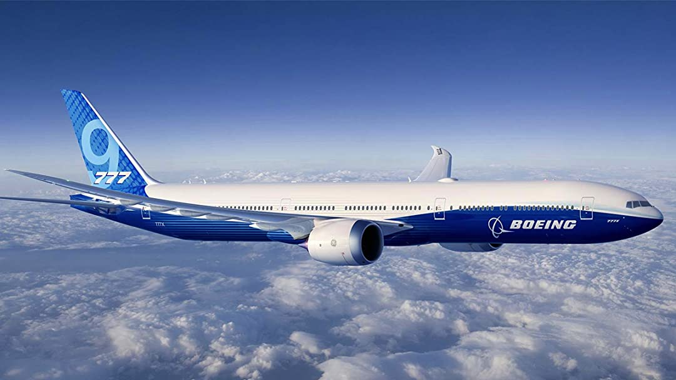
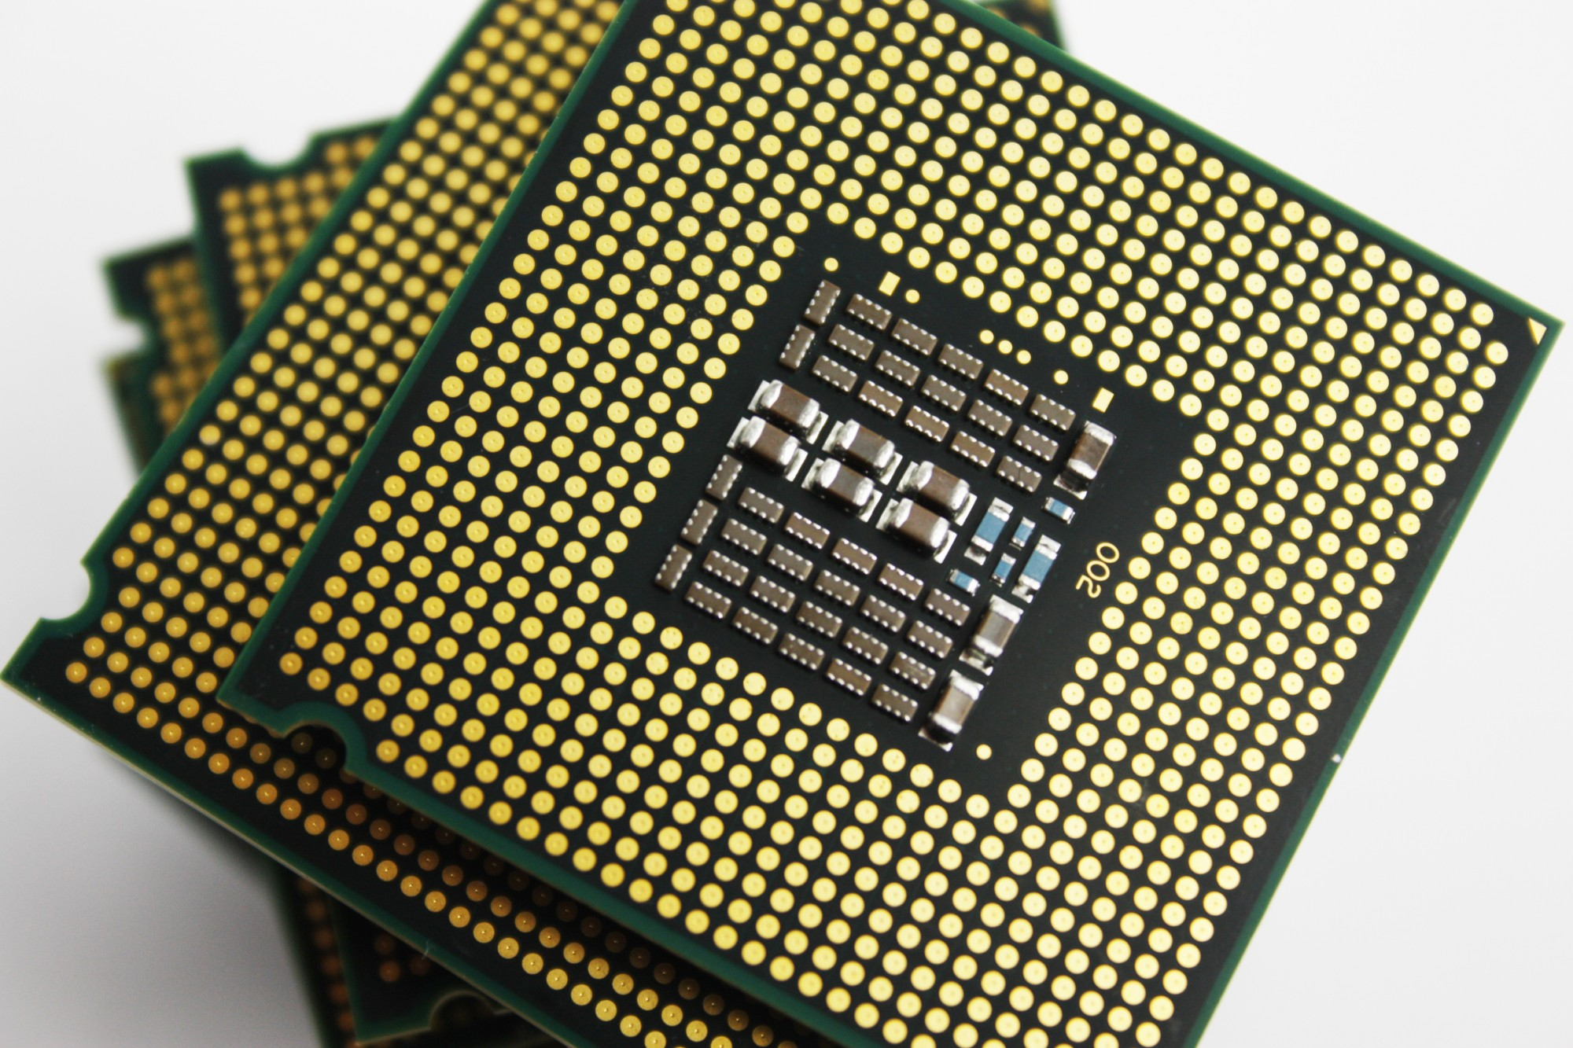
Cyber-Physical Systems (CPS)
NASA report: https://ntrs.nasa.gov/citations/20050157919
Verge: https://www.theverge.com/2020/4/9/21197162/boeing-737-max-software-hardware-computer-fcc-crash

Slide 3
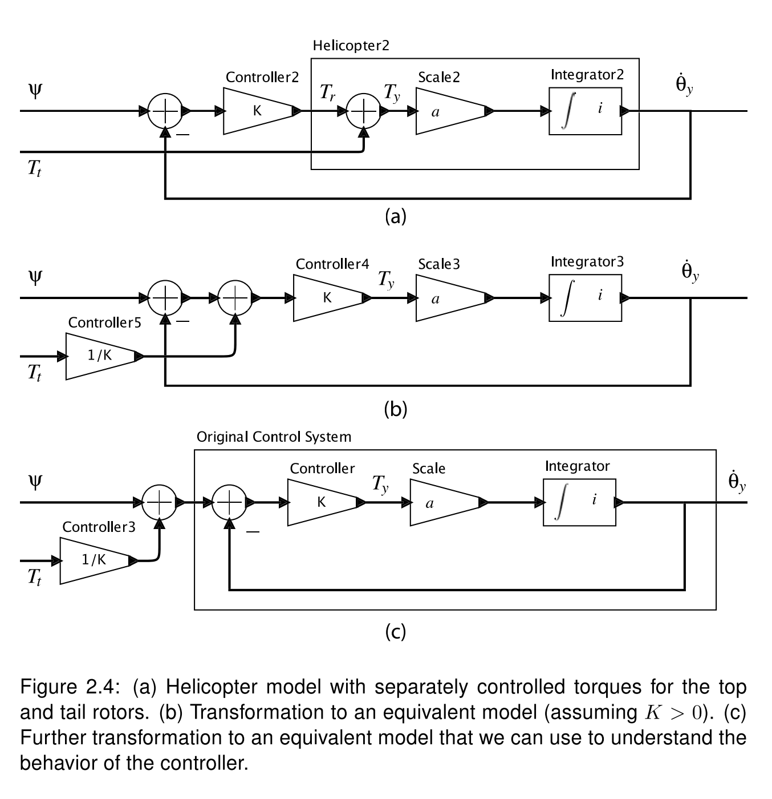
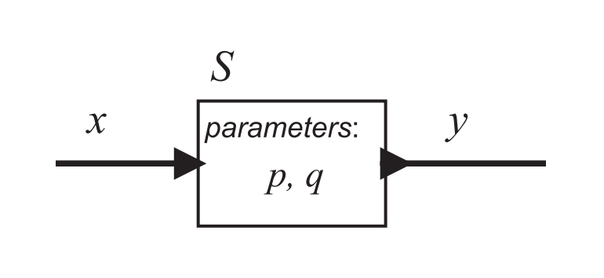
Actor Model
A mathematical model for describing concurrent systems
Bundles of data and message handlers
“Actor” is the universal primitive. It can send messages, react to incoming messages, and create more actors.
Actors can be composed under a topology and form a larger system.
S(x) = y
[Lee & Seshia., 2017]
Notes:
Why actor model?

Slide 4
Logical Time
Network
layer
A
t1
C
t2
B
t1 < t2
Messages are handled in timestamped order.
Notes:
Why is Reactor deterministic?
Explain logical time better.

Slide 5
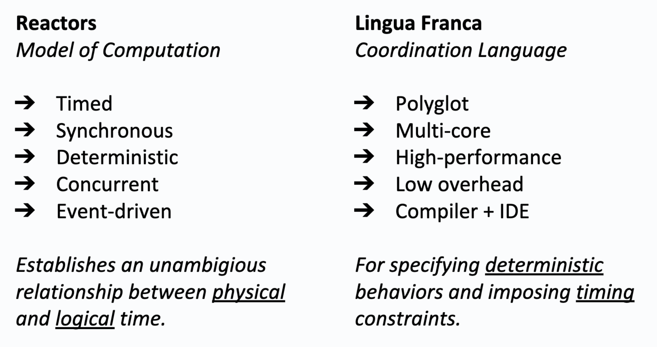
Reactors and Lingua Franca (LF)
Github: https://github.com/icyphy/lingua-franca
[Lohstroh et al., 2019]

Slide 6
How LF works behind the scene

Slide 7
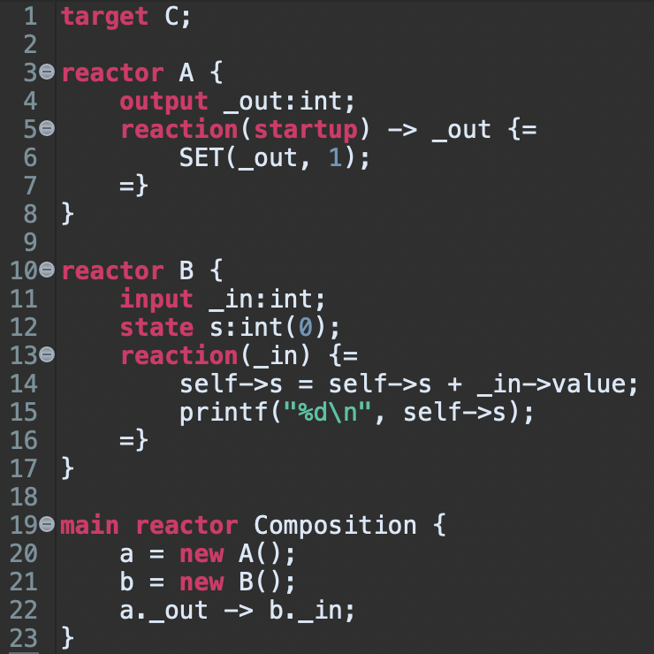
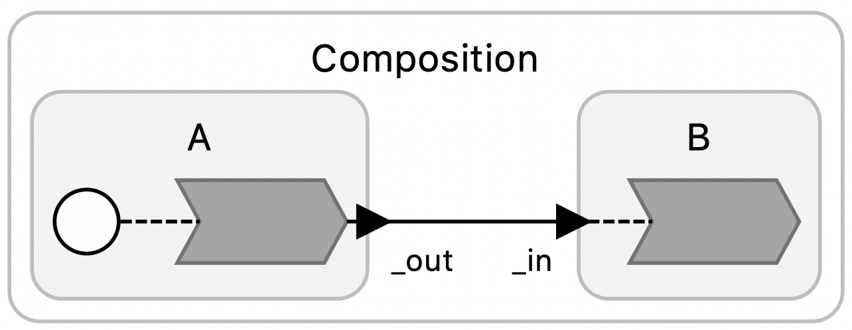
A simple example
Graphical representation of the topology

Slide 8
A simple example
EventQ
Sorting events by timestamp
ReactionQ
Sorting events by topology
Graphical representation of the topology

Slide 9
A simple example
EventQ
startup
t = 0
Sorting events by timestamp
ReactionQ
Sorting events by topology
Graphical representation of the topology

Slide 10
A simple example
EventQ
Sorting events by timestamp
ReactionQ
Sorting events by topology
Startup
t = 0
Graphical representation of the topology

Slide 11
A simple example
EventQ
Sorting events by timestamp
ReactionQ
Sorting events by topology
exec…
Graphical representation of the topology

Slide 12
A simple example
EventQ
Sorting events by timestamp
ReactionQ
Sorting events by topology
_in
t = 0
Graphical representation of the topology

Slide 13
A simple example
EventQ
Sorting events by timestamp
ReactionQ
_in
t = 0
Sorting events by topology
Graphical representation of the topology

Slide 14
A simple example
EventQ
Sorting events by timestamp
ReactionQ
Sorting events by topology
_in
t = 0
Graphical representation of the topology

Slide 15
A simple example
EventQ
Sorting events by timestamp
ReactionQ
Sorting events by topology
exec…
Graphical representation of the topology

Slide 16
A simple example
EventQ
Sorting events by timestamp
ReactionQ
Sorting events by topology
✅
Graphical representation of the topology

Slide 17
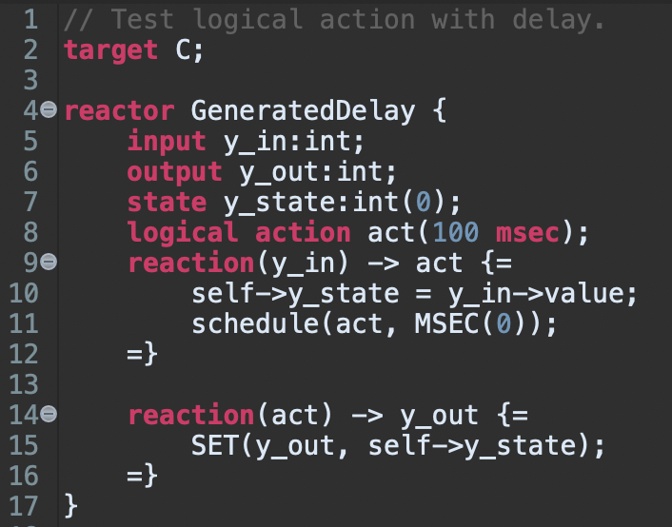
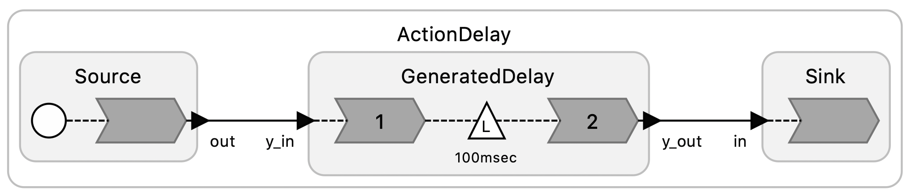
Another quick example…
EventQ
act
t + 100 msec
Sorting events by timestamp
ReactionQ
Sorting events by topology
Graphical representation of the topology

Slide 18
Another quick example…
foo
t + 1 msec
EventQ
act
t + 100 msec
Sorting events by timestamp
ReactionQ
Sorting events by topology
Graphical representation of the topology

Slide 19
Another quick example…
EventQ
foo
t + 1 msec
act
t + 100 msec
Sorting events by timestamp
ReactionQ
Sorting events by topology
Graphical representation of the topology

Slide 20
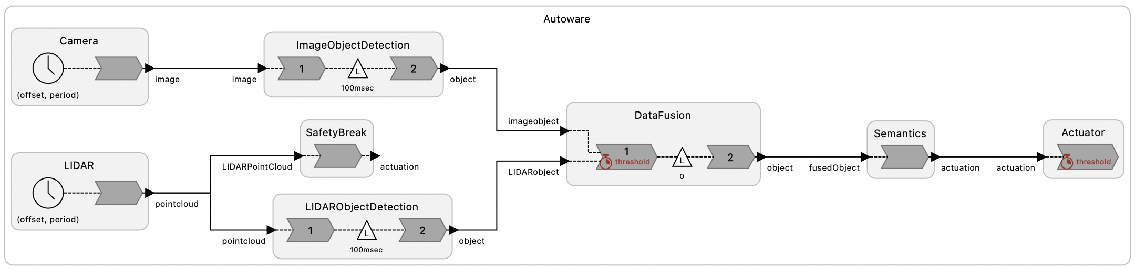
System can be complex

Slide 21
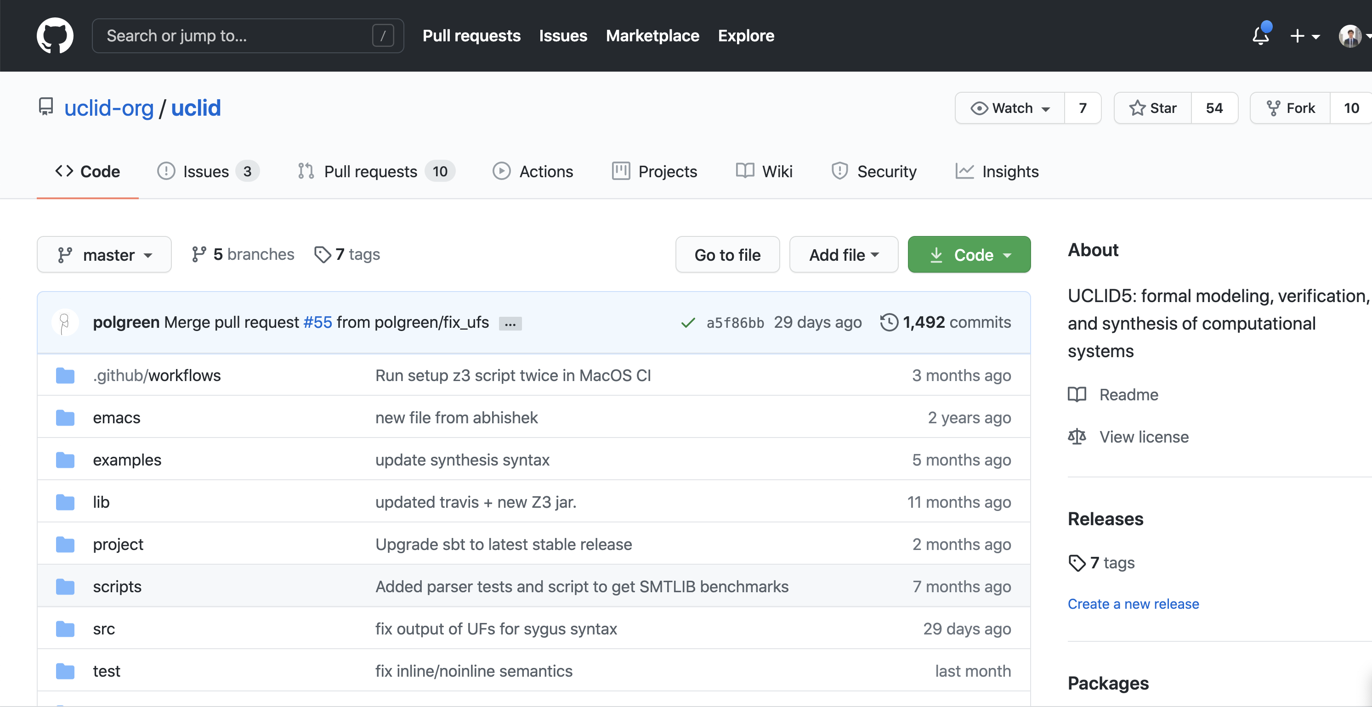

UCLID5

Slide 22
Verification Problem
Can we use model checking to find unsafe states in a Lingua Franca program?

Slide 23

Translating LF to UCLID5

Slide 24
Translation approach
Lingua Franca Construct/Features | UCLID5 Construct/Features
reactor | reactor modules
reaction | procedures in reactor modules
trigger | event_t in Common
state/action/input | state variables in reactor modules
output | output buffer logic in reactor modules
timing | clock in Scheduler
scheduling | PQueue and Scheduler
main | main module
Instantiation (new) | module instantiations
connection | derived from dependency graph

Slide 25
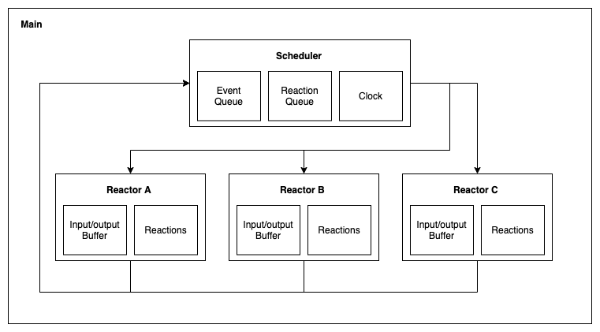
Mapping LF into UCLID5

Slide 26
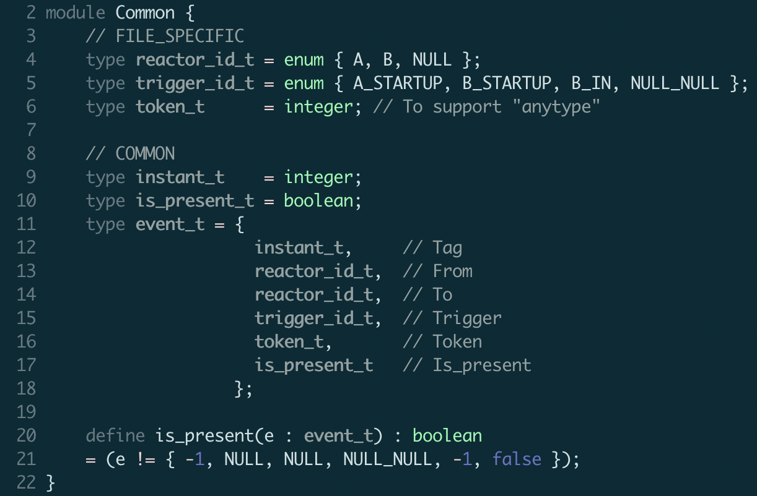
Common

Slide 27
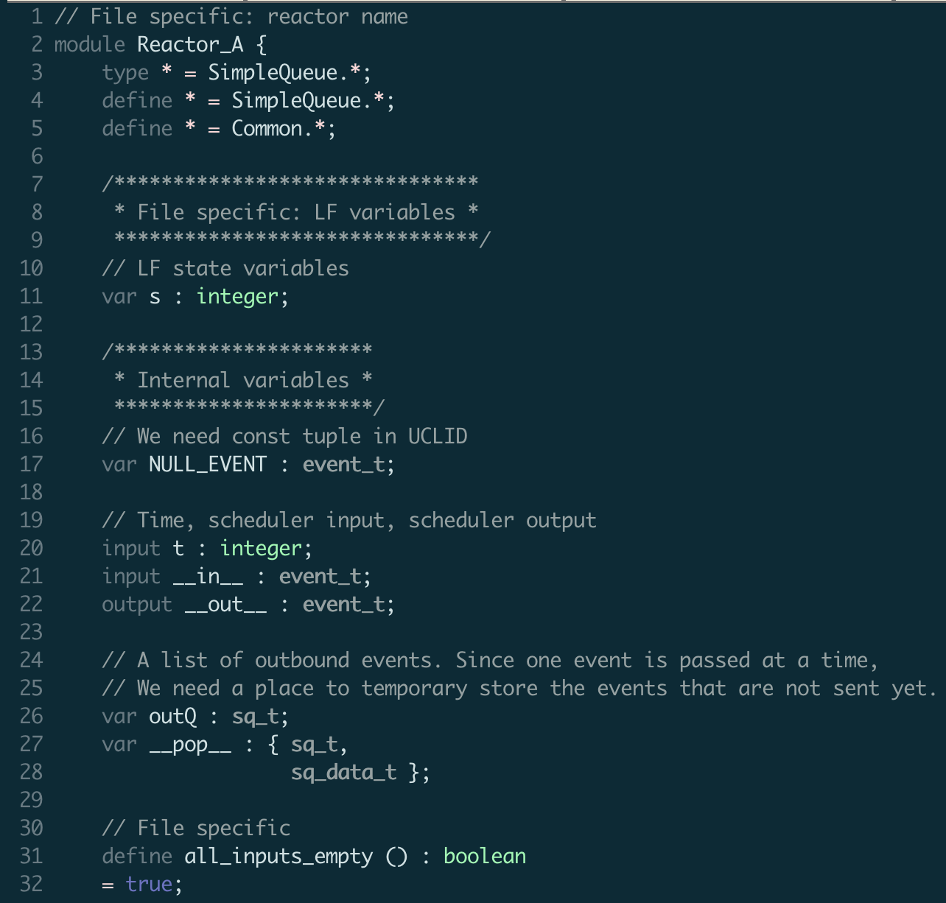
Reactor A

Slide 28
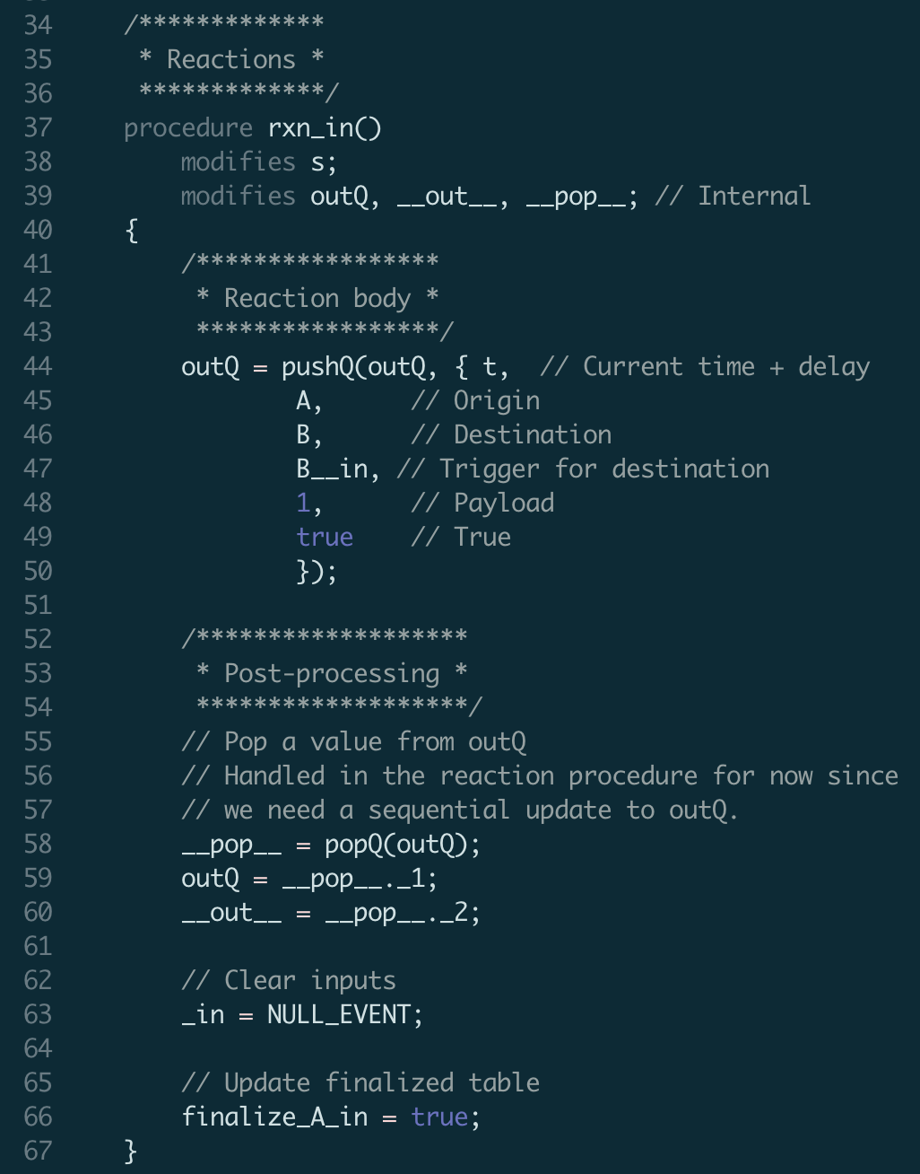
Reactor A

Slide 29
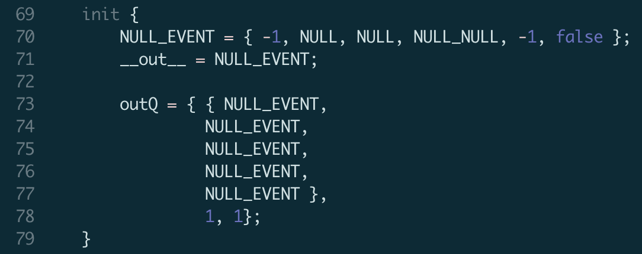
Reactor A

Slide 30
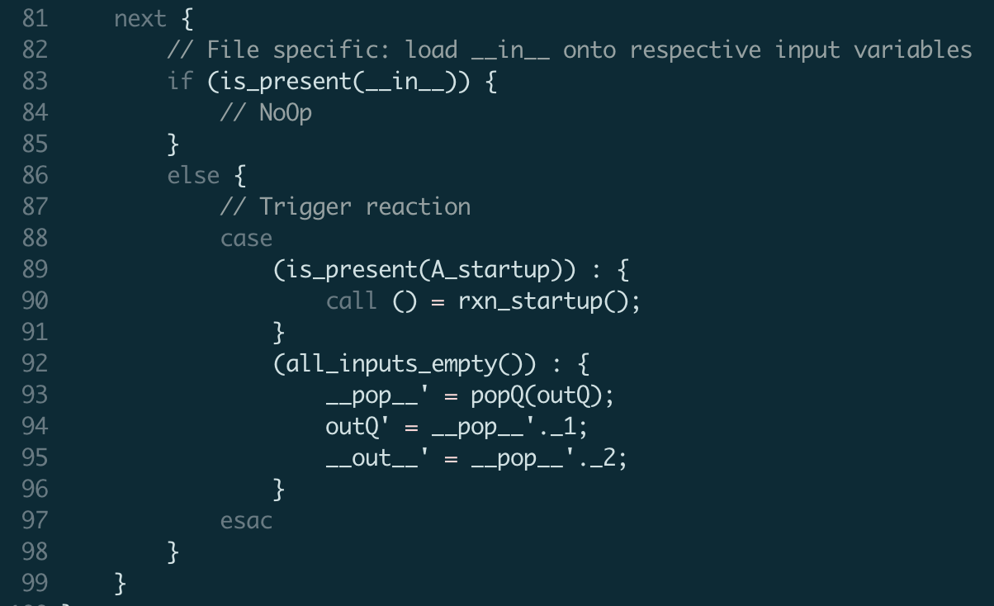
Reactor A

Slide 31
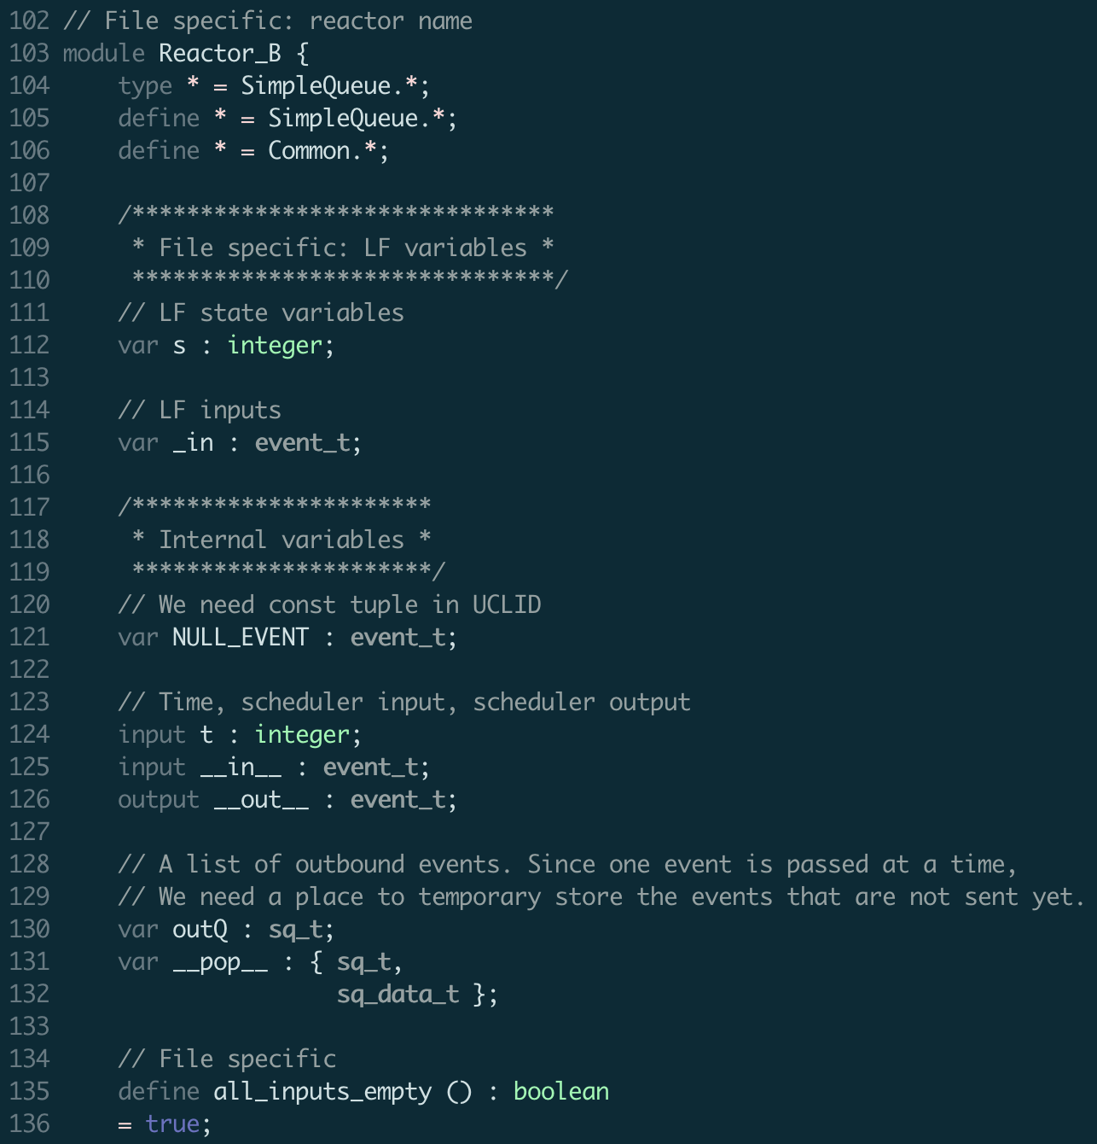
Reactor B

Slide 32
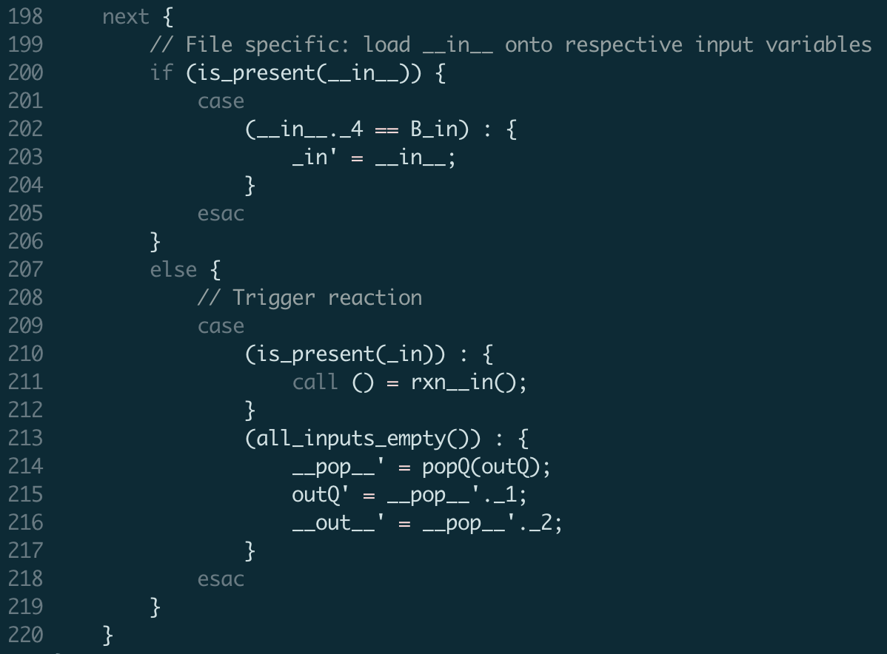
Reactor B

Slide 33
Mapping LF into UCLID5

Slide 34
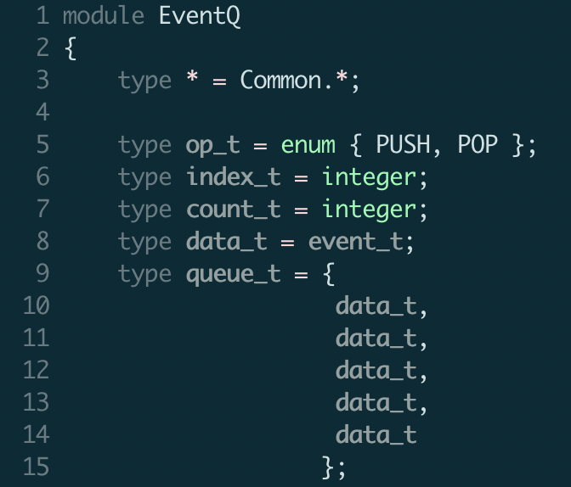
Event Queue

Slide 35
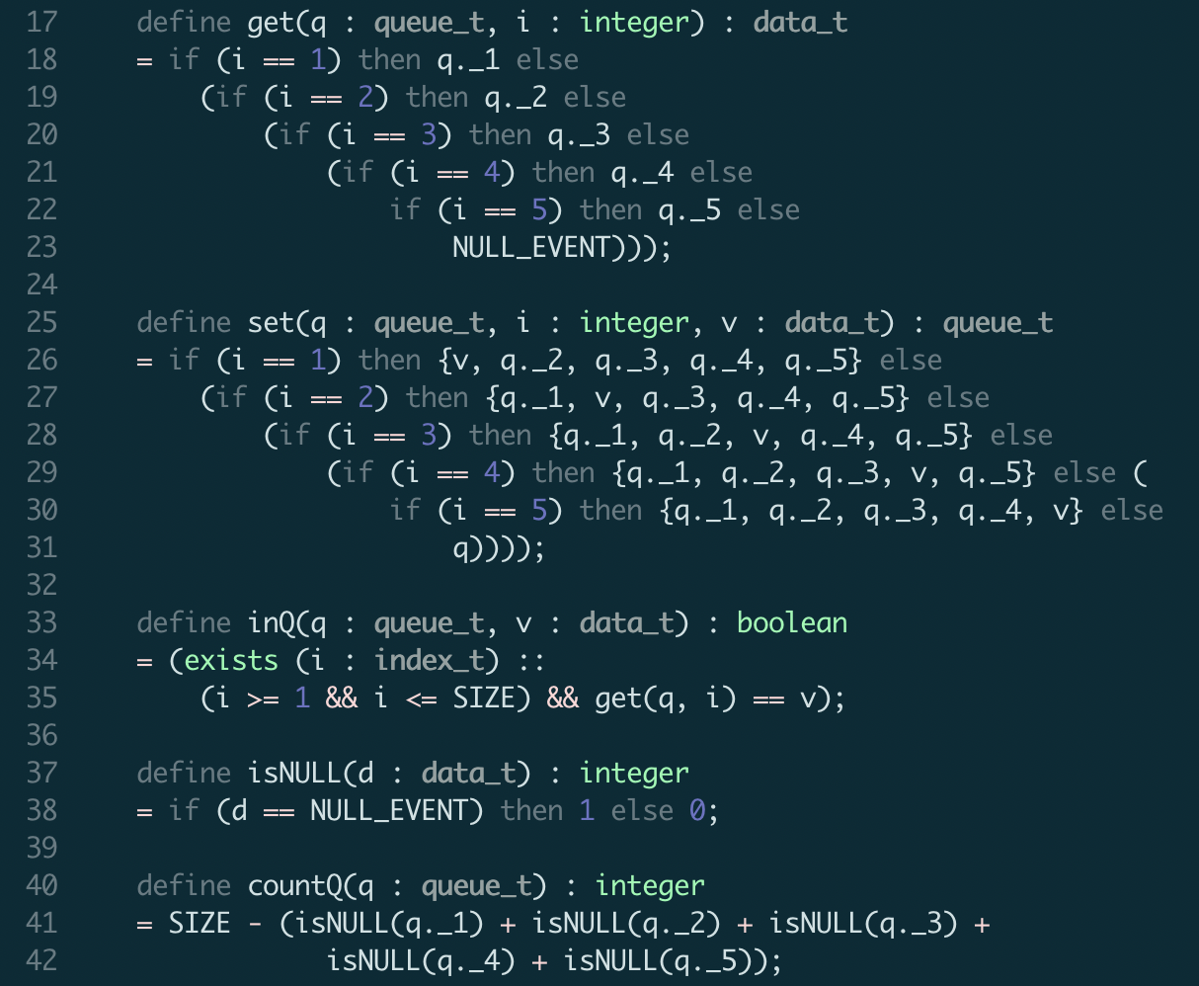
Event Queue

Slide 36
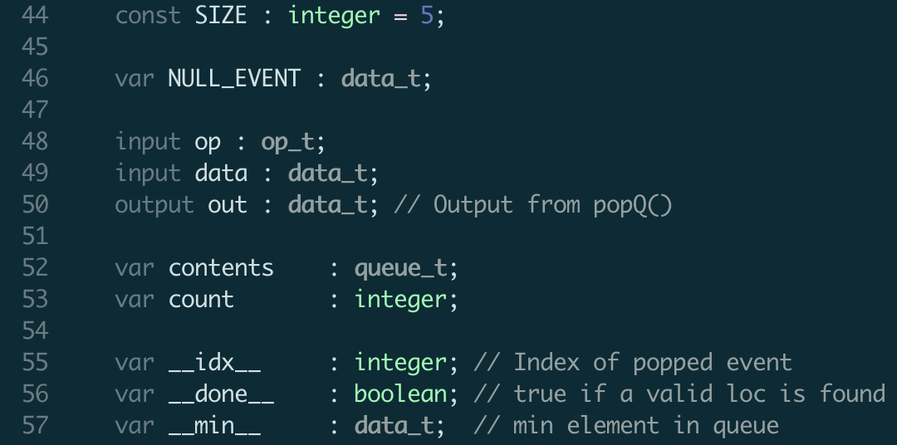
Event Queue

Slide 37
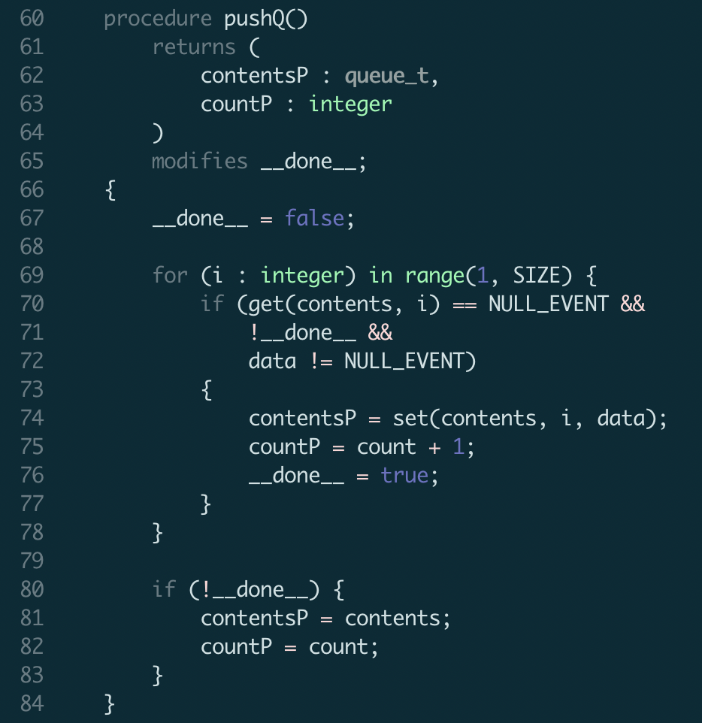
Event Queue

Slide 38
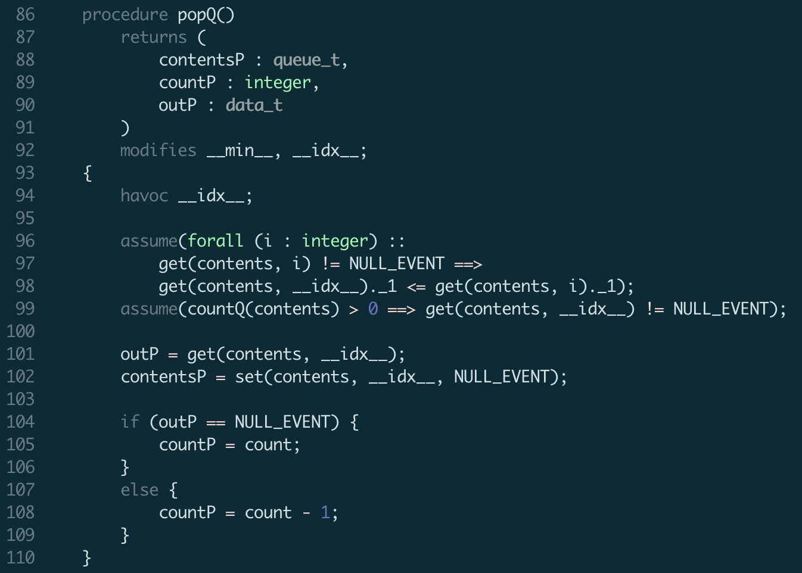
Event Queue

Slide 39
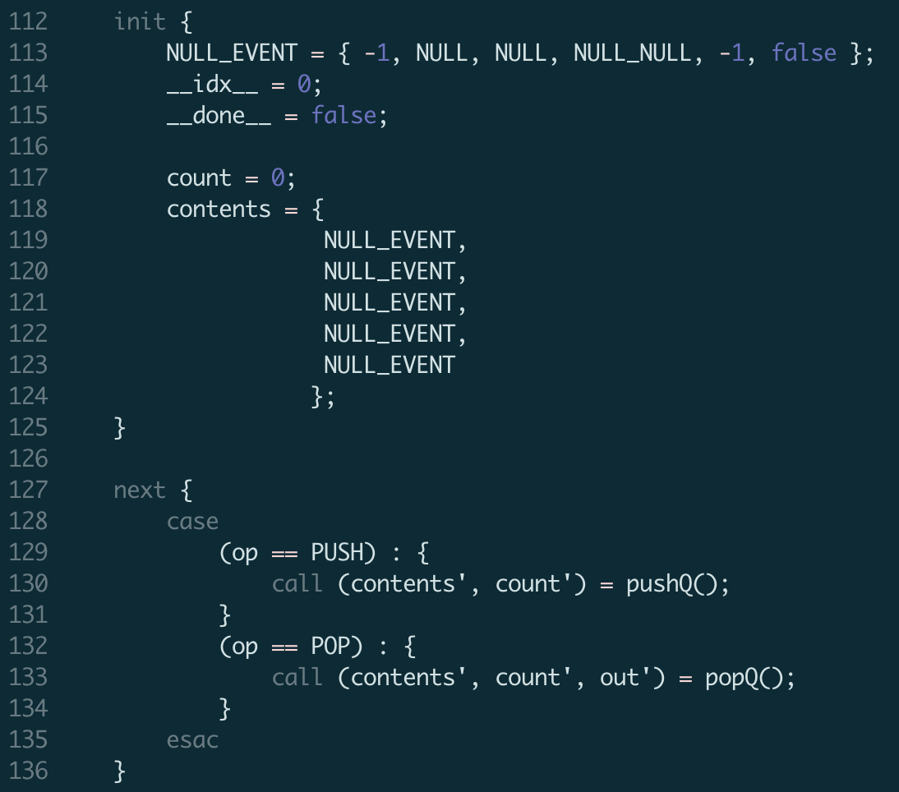
Event Queue

Slide 40
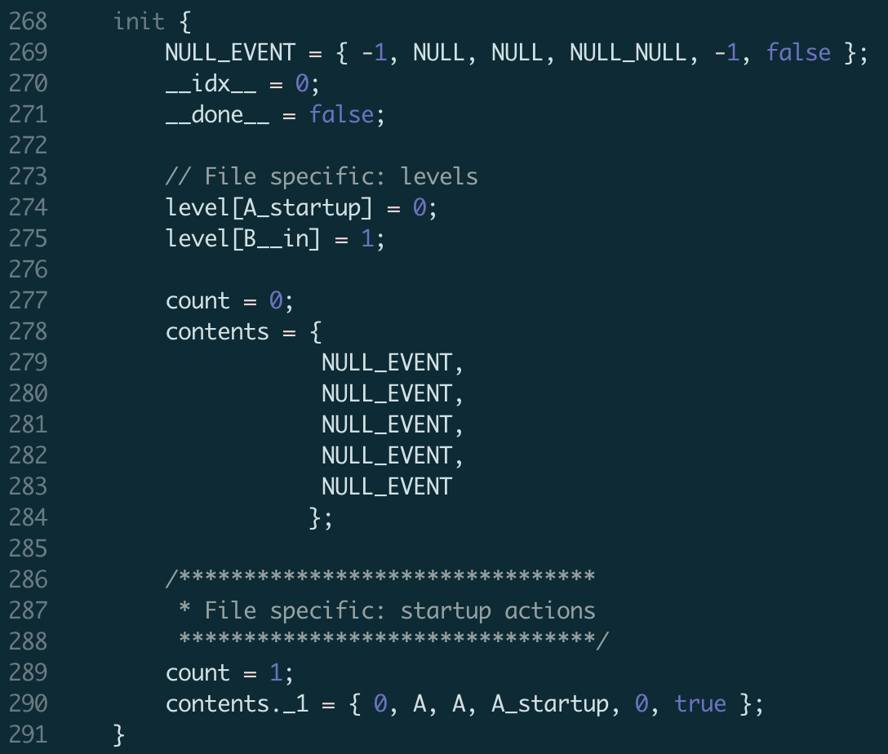
Reaction Queue (EQ w/ subtle changes)

Slide 41
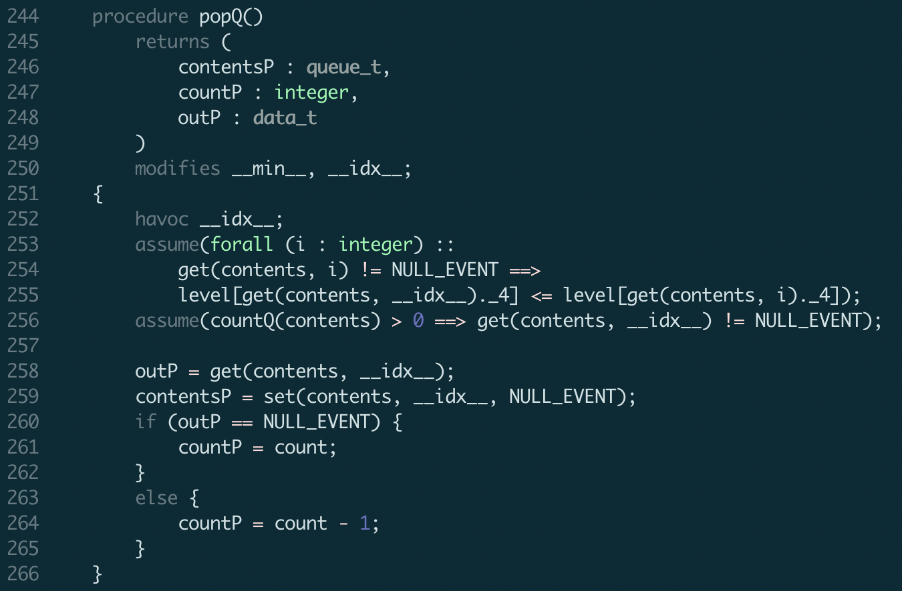
Reaction Queue (EQ w/ subtle changes)

Slide 42
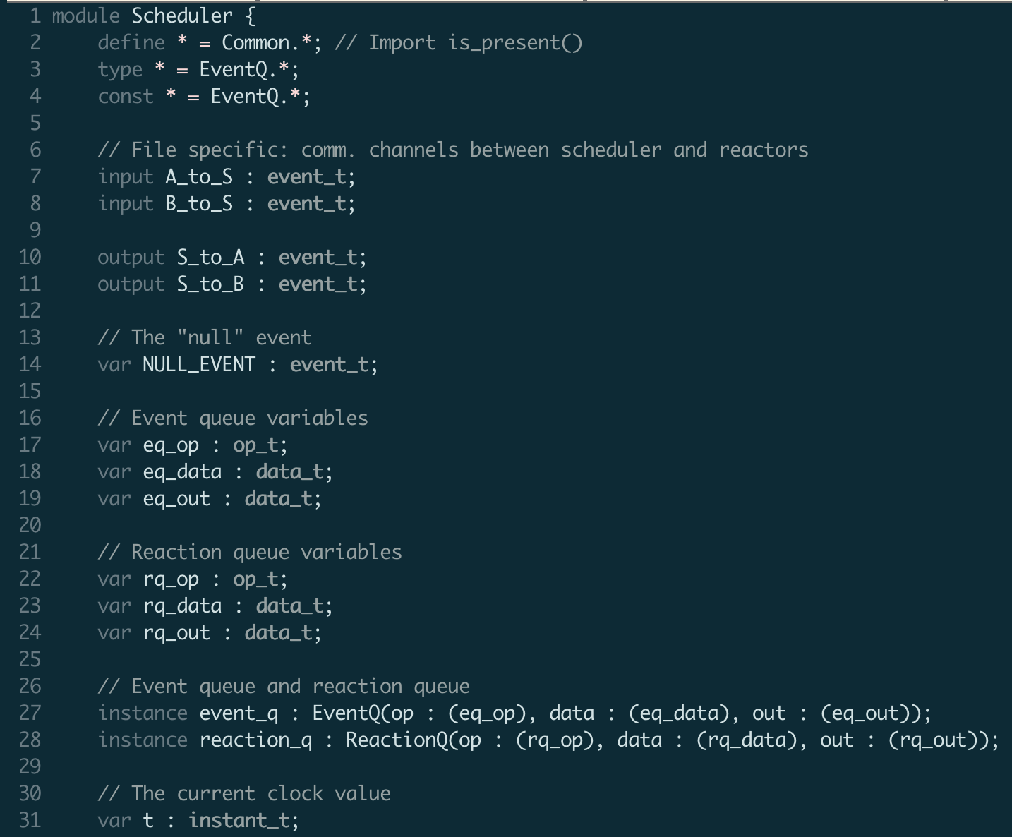
LF Scheduler

Slide 43
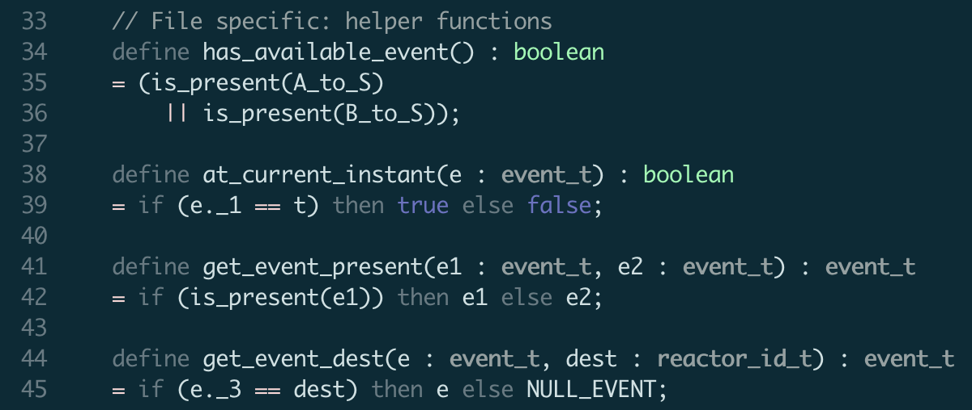
LF Scheduler

Slide 44
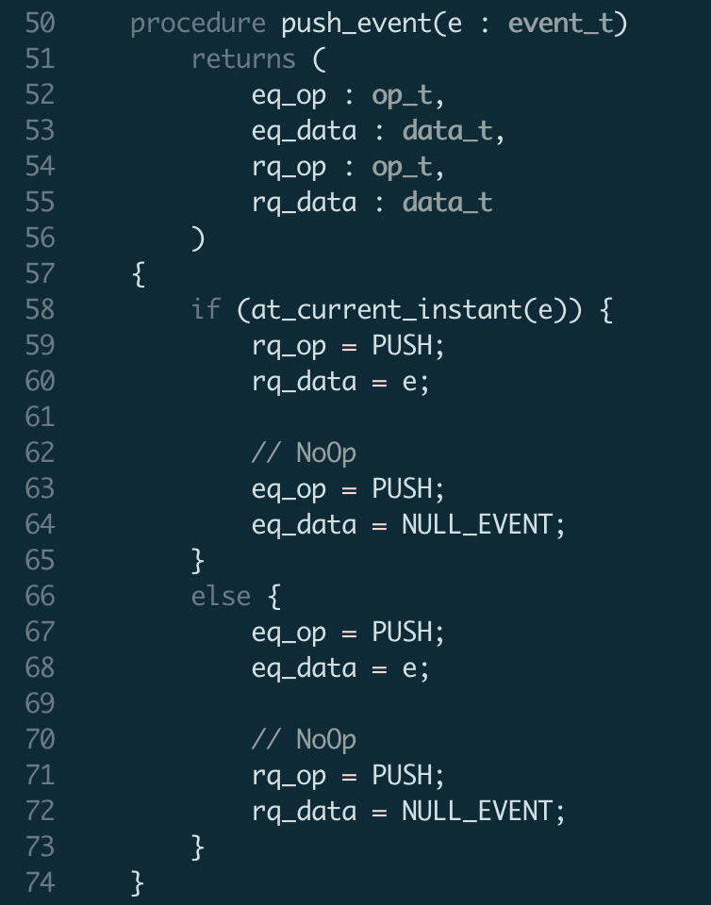
LF Scheduler

Slide 45
LF Scheduler

Slide 46
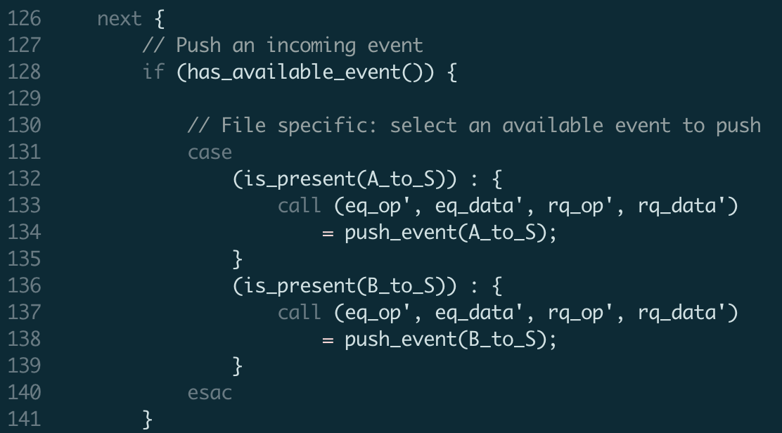
LF Scheduler

Slide 47
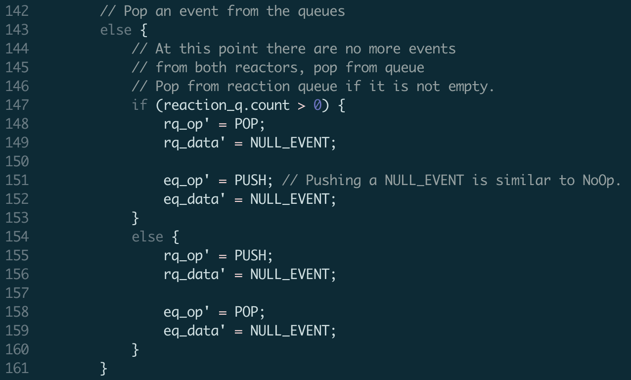
LF Scheduler

Slide 48
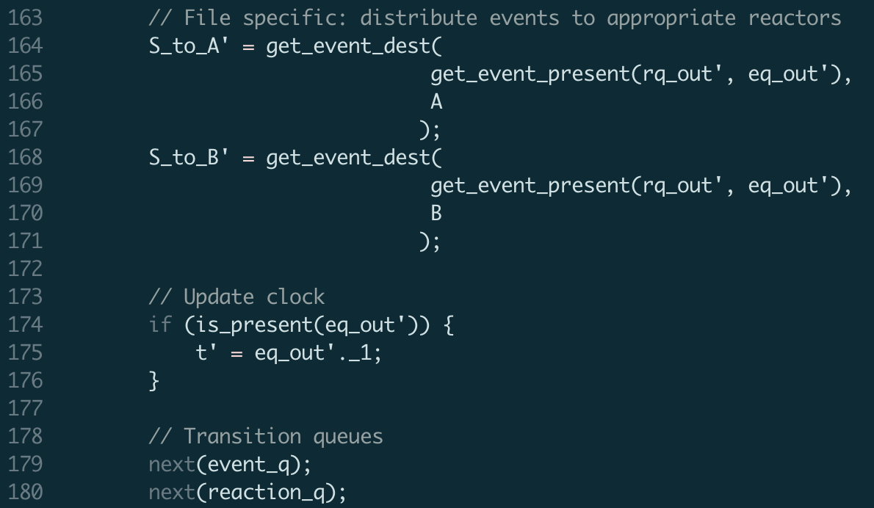
LF Scheduler

Slide 49
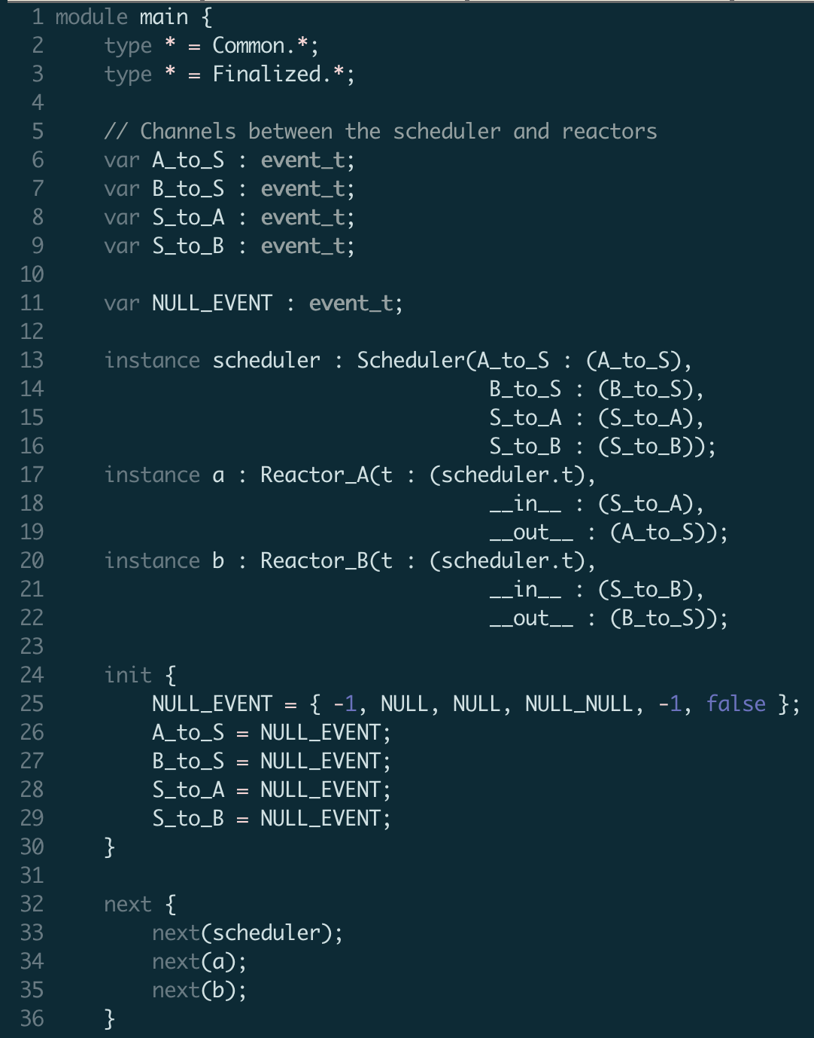
Main Module

Slide 50
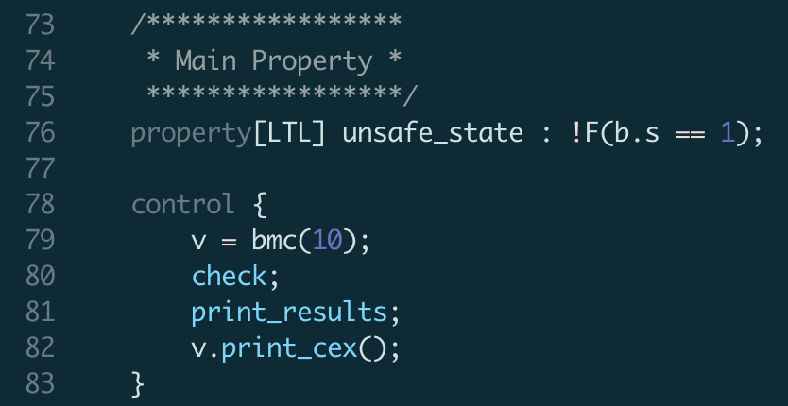
Main Module

Slide 51
Mapping LF into UCLID5

Slide 52
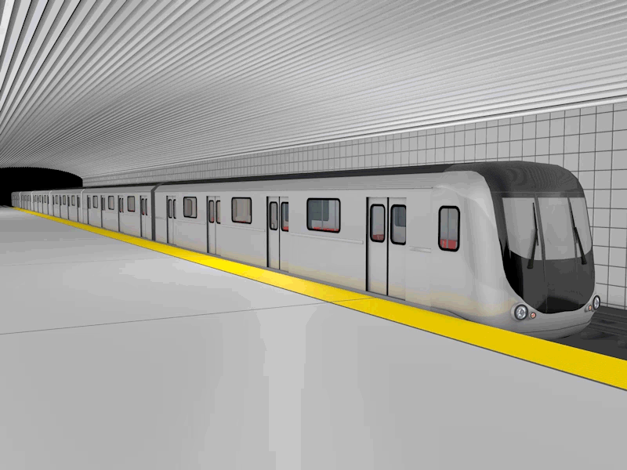

Train Door Example
in control car
Mode 1:
Door unlocked,
Train stopped
Button press
Mode 2:
Door locked,
Train moving
What if Controller, Train, and Door are separated by a network?
Unsafe state: unlocked & moving

Slide 53
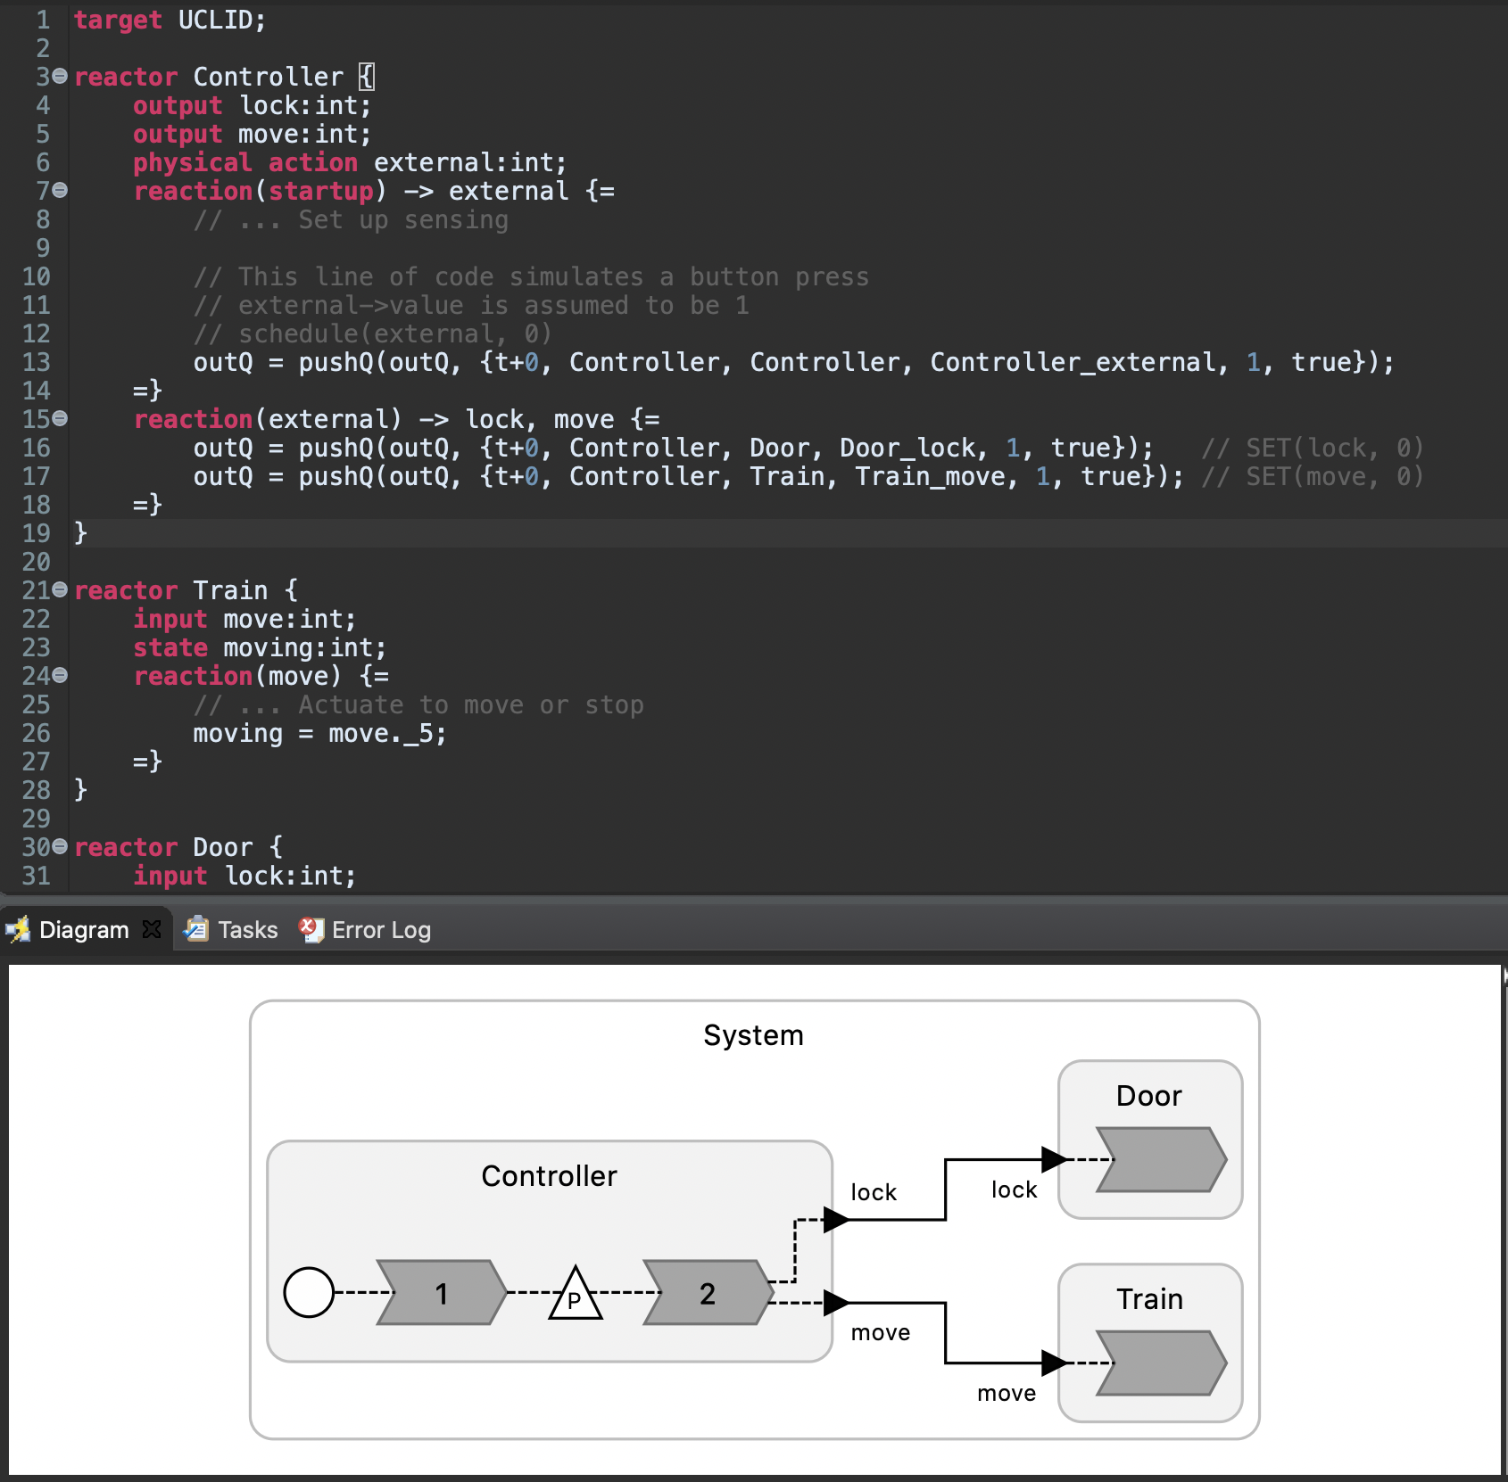
TrainDoor.lf Demo

Slide 54
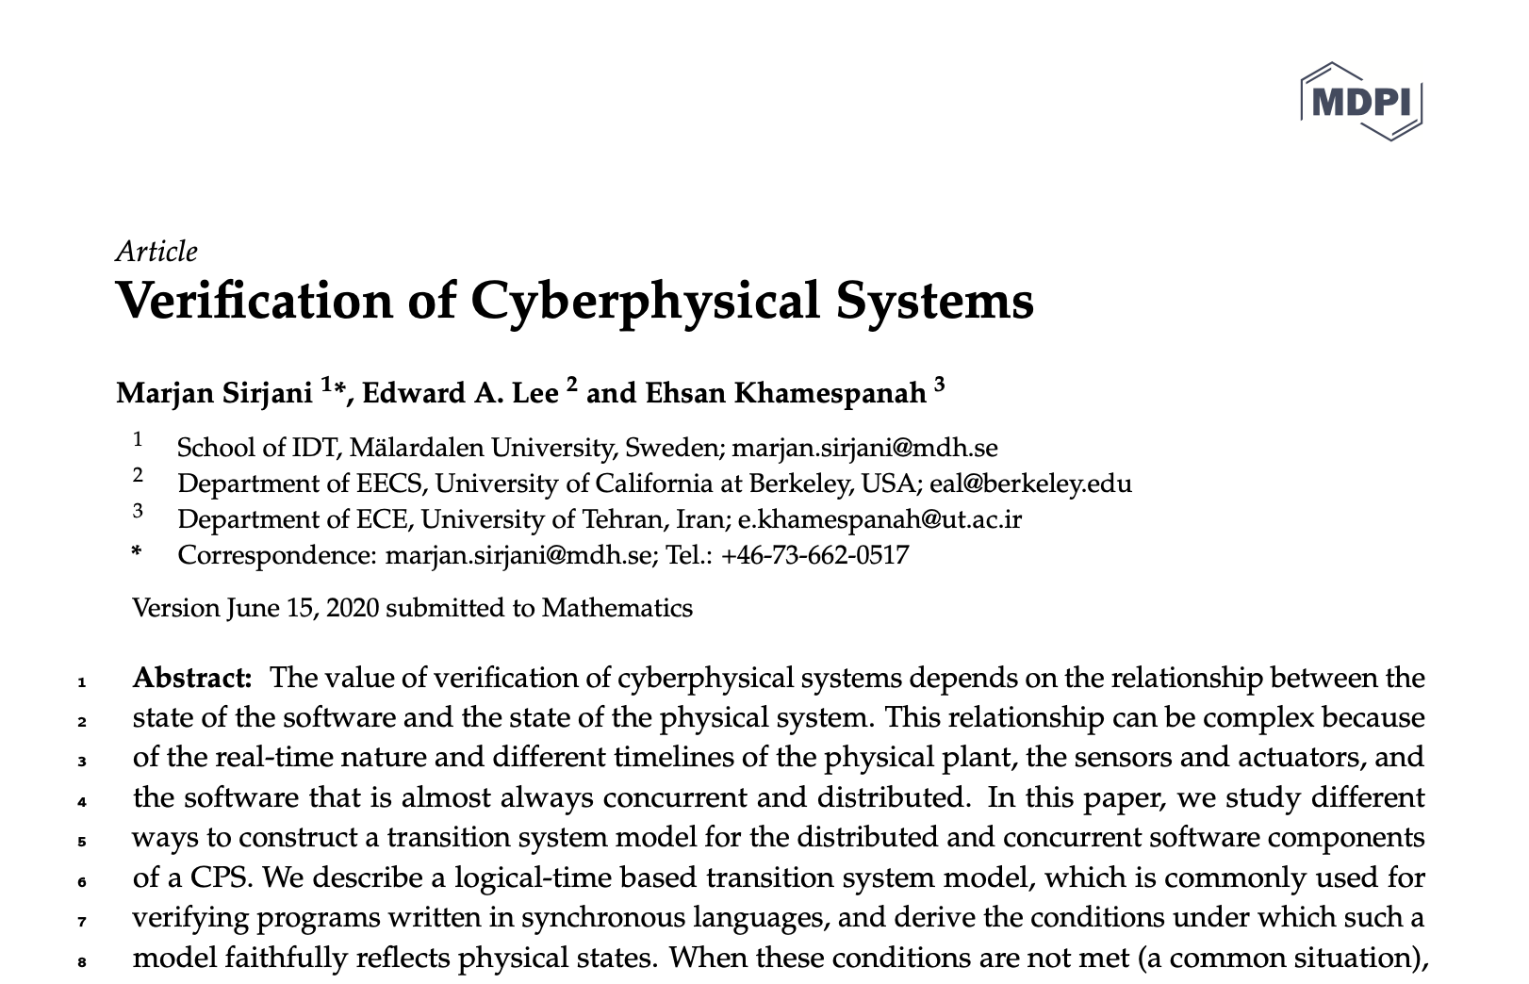
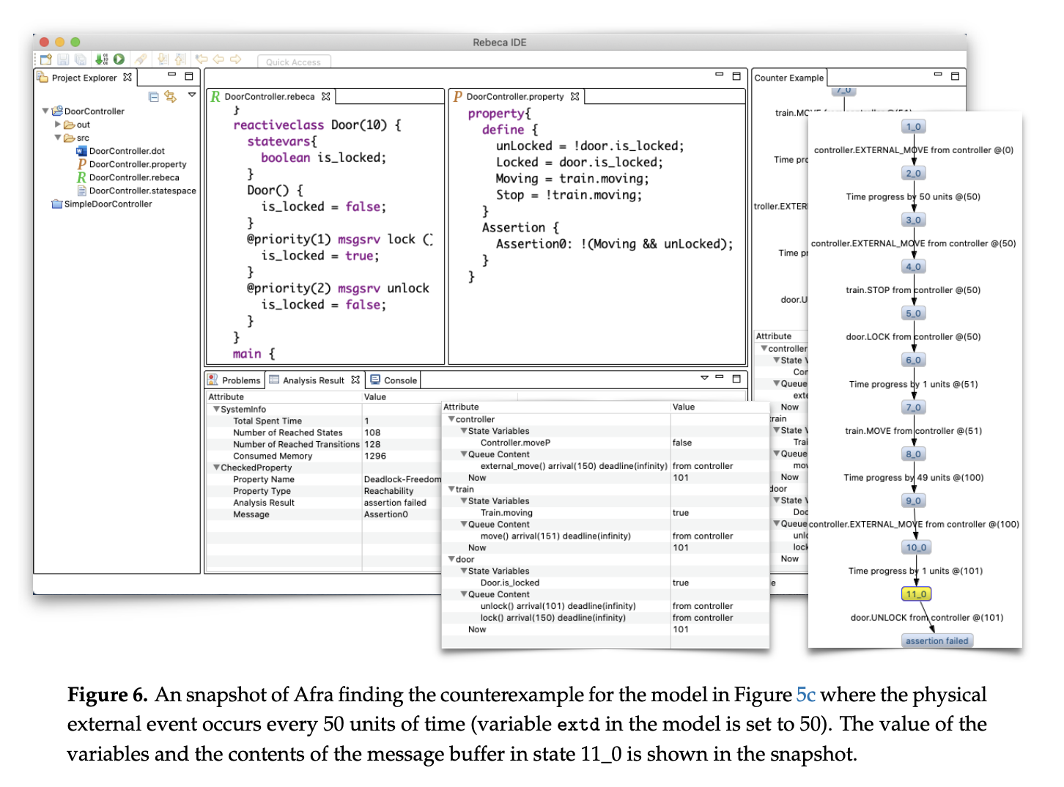
Related Work
Notes:
Change the encoding, not the tool.

Slide 55
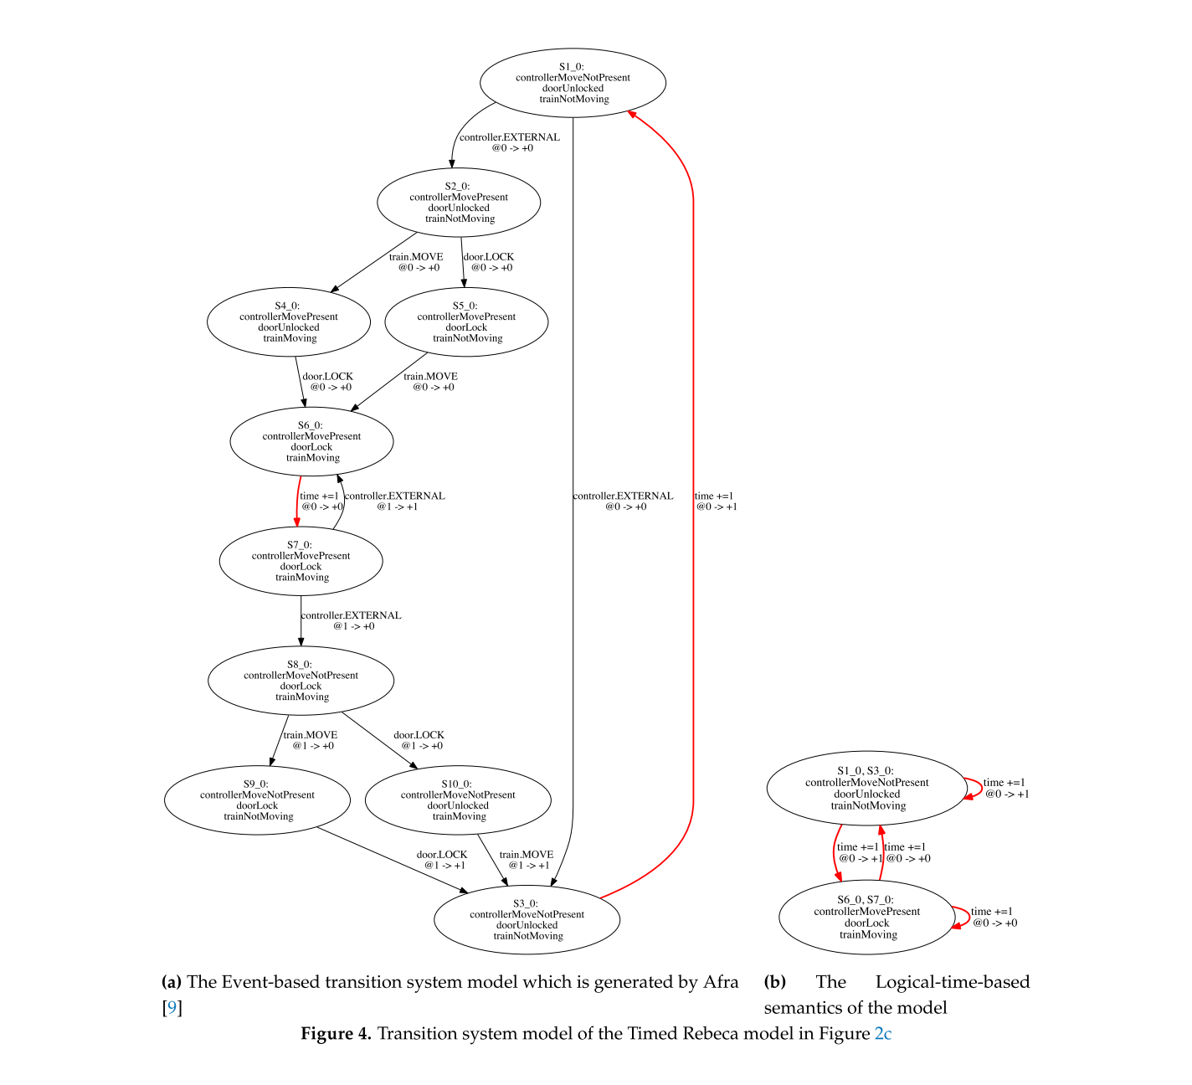
[Sirjani et al., 2020]

Slide 56
How do we go beyond event-based semantics?

Slide 57
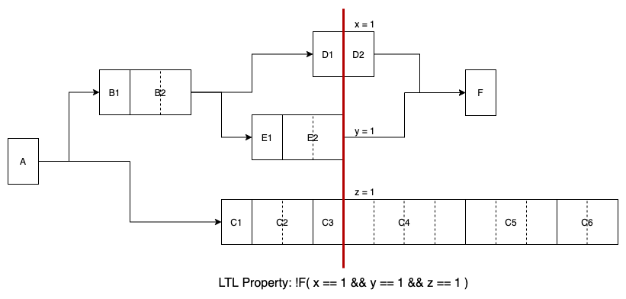
Observation points
To account for multithreaded / distributed executions
To check for unsafe states during parallel executions

Slide 58
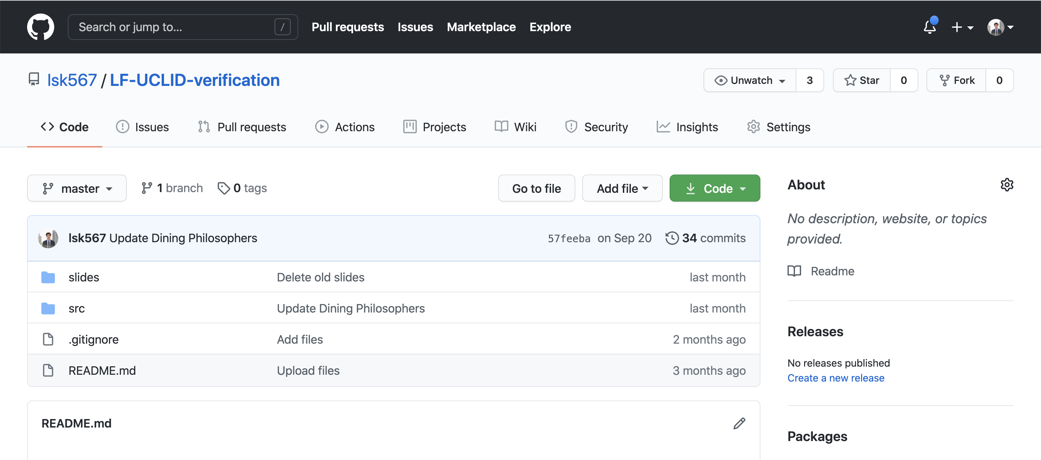
Code
Github: https://github.com/lsk567/LF-UCLID-verification

Slide 59
Thank you!

Slide 60
Backup slides

Slide 61
Verifying Cyber-Physical Systems
Cyber
Physical
For the cyber part alone, there are a few questions to consider:
Correctness of reaction code
Schedulability
Single-threaded, multi-threaded, distributed executions
Uncertainties (network delay, sensor output, etc.)
Properties related to these questions can be specified using pre/post conditions, and Linear Temporal Logic (LTL).

Slide 62
Template

